Slide 1
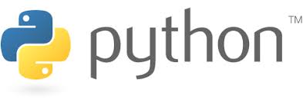

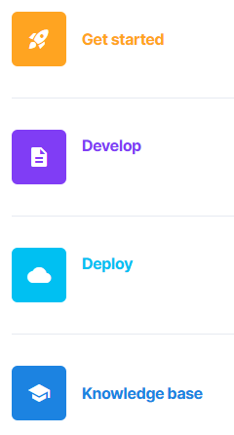
Advanced Data Analytics
Instructor: Chris Santo
Lab: Financial Analysis using yfinance and streamlit
Wednesday 6/3/2026

Slide 2

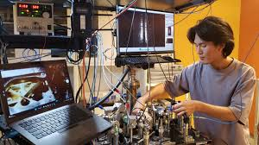
Warning: Experimental
I've never run these labs in a classroom. This is an experiment, so our results may vary. Please be kind on my surveys ☺

Slide 3

Streamlit – Financial Analysis Lab
Now we will create a financial analysis app in Streamlit using yfinance.
Goals:
Create an interactive financial analysis app that uses yfinance data in streamlit.

Slide 4
Streamlit – Financial Analysis Lab
In the world of finance, understanding stock price trends, calculating performance metrics, and optimizing portfolios is crucial for making informed investment decisions.
In this lab, we’ll build a financial analysis web app using Streamlit, Yahoo Finance, and Python libraries like pandas, matplotlib, and yfinance.
Our app will allow users to explore stock price data, visualize trends, calculate key performance metrics like the Sharpe and Sortino ratios, and even optimize their portfolio weights.

Slide 5
Streamlit – Financial Analysis Lab
What we will build
Stock Data Fetching: Using Yahoo Finance to download stock data.
Visualizations: Displaying stock prices and returns with line charts.
Performance Metrics: Calculating key financial ratios, including Sharpe and Sortino ratios.
Portfolio Optimization: Helping users to balance their investments in an optimal portfolio.
Download Option: Allowing users to download the stock data.

Slide 6
Streamlit – Financial Analysis Lab
Let's start by creating a new app file in your github repository called "finanalysis.py"
We will add the fetch_data function with three parameters: tickers, start_date and end_date. This will serve as a "wrapper function" to the yfinance API. Code on next slide.
(Instructor to Demo)

Slide 7
Streamlit – Financial Analysis Lab
Add the following code to your finanalysis.py file:
import yfinance as yf
import pandas as pd
def fetch_data(tickers, start_date, end_date):
data_frames = []
for ticker in tickers:
stock_data = yf.download(ticker, start=start_date, end=end_date)['Close']
data_frames.append(stock_data)
data = pd.concat(data_frames, axis=1, keys=tickers)
data.columns = tickers
return data
(Instructor to Demo)

Slide 8
Streamlit – Financial Analysis Lab
Since our app requires yfinance, and yfinance is not automatically installed in the Streamlit Community Cloud, we need to create a "requirements.txt" file in our github repository.
Create a new file called "requirements.txt" and add the following line to it:
yfinance
(Instructor to Demo)

Slide 9
Streamlit – Financial Analysis Lab
Before anything shows up on our web app, we need to add some calls to the streamlit api.
The code is on the next slide.
Add the import line at the top and the rest of the code below the fetch_data function

Slide 10
import streamlit as st # add at top with other imports, the rest at the bottom
st.title("Financial Analysis Web App")
# User inputs
tickers = st.text_input("Enter stock tickers (comma separated)", "AAPL, MSFT, GOOG").split(",")
tickers = [ticker.strip() for ticker in tickers]
start_date = st.date_input("Start Date", pd.to_datetime("2020-01-01"))
end_date = st.date_input("End Date", pd.to_datetime("2023-01-01"))
# Fetch stock data
stock_data = fetch_data(tickers, start_date, end_date)
returns_data = stock_data.pct_change().dropna()
# Visualizations
st.subheader("Stock Prices")
st.line_chart(stock_data)
st.subheader("Stock Returns")
st.line_chart(returns_data)

Slide 11
Streamlit – Financial Analysis Lab
The code on the previous slide enables the user inputs for ticker, start date and end date. It also displays two visualizations for stock price trends and daily returns.
Next, we’ll compute two key metrics used in finance to measure risk-adjusted returns:
Sharpe Ratio: A ratio that compares the return of an investment to its risk.
Sortino Ratio: A variation of the Sharpe ratio, but it only considers the downside risk (negative returns).

Slide 12
Streamlit – Financial Analysis Lab
Add these new functions below your first fetch_data function:
def calculate_sharpe_ratio(returns, risk_free_rate=0.02):
portfolio_return = returns.mean().mean()
portfolio_volatility = returns.std().mean()
return (portfolio_return - risk_free_rate) / portfolio_volatility
def calculate_sortino_ratio(returns, risk_free_rate=0.02):
portfolio_return = returns.mean().mean()
downside_returns = returns[returns < 0]
downside_deviation = downside_returns.std().mean()
return (portfolio_return - risk_free_rate) / downside_deviation
(Instructor to Demo)

Slide 13
Streamlit – Financial Analysis Lab
Now add this code at the bottom of your finanalysis.py file:
sharpe_ratio = calculate_sharpe_ratio(returns_data)
sortino_ratio = calculate_sortino_ratio(returns_data)
st.subheader("Performance Metrics")
st.write(f"Sharpe Ratio: {sharpe_ratio:.2f}")
st.write(f"Sortino Ratio: {sortino_ratio:.2f}")
(Instructor to Demo)

Slide 14
Streamlit – Financial Analysis Lab
We can use a simple equal-weighted portfolio or implement more advanced optimization algorithms.
For this next step, let’s start with an equal-weighted portfolio.
First add the import with the other imports in your file:
import numpy as np

Slide 15
Streamlit – Financial Analysis Lab
Add this new function below your other functions:
def portfolio_optimization(returns):
return np.ones(len(returns.columns)) / len(returns.columns)
(Instructor to Demo)

Slide 16
Streamlit – Financial Analysis Lab
Add this code to the bottom of the file:
optimal_weights = portfolio_optimization(returns_data)
st.subheader("Portfolio Optimization")
st.write("Optimal Portfolio Weights:")
for ticker, weight in zip(tickers, optimal_weights):
st.write(f"{ticker}: {weight:.2%}")
(Instructor to Demo)

Slide 17
Streamlit – Financial Analysis Lab
Now let's provide users with the option to download the stock data they are analyzing. Streamlit makes this super easy with the download_button widget.
Add the following code to the bottom of your file:
csv_data = stock_data.to_csv()
st.download_button("Download Stock Data CSV", csv_data, "stock_data.csv")

Slide 18
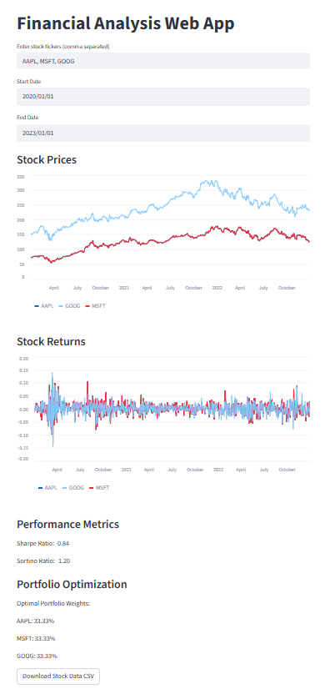
Streamlit – Financial Analysis Lab
Commit all the changes and deploy your app to the Streamlit Cloud.
Looks great!

Slide 19

Streamlit – Financial Analysis Lab
Reflections – Comments – Questions?

Slide 20

End

